Slide 1
1. 内容要点服从于角色，高质量完成交际任务
李华具体角色：第一层级信息-----背景信息（很多考生忽视背景信息，只关注内容要点） 共同能力，角色代入 交际方向和拓展真实有效的交际内容。
年份 | 2017-11
写作体裁 | 邀请信 7.1
背景信息 | 邀请外教到家过春节
开放要点 | 春节活动安排
素养体现 | 文化输出和交流意识
seeing films
playing computer games
singing and dancing
making dumplings
red paper cutting
taste local flavor snacks
family reunion dinner
go to the temple fair
set off fireworks
VS
最能成功邀请的活动安排应是外教感兴趣的，体现民风民俗的，
体现文化自信。活动行程安排上要合理拓展，具有“传播中华文化、
讲述中国故事”的意识和能力。

Slide 2
1. 内容要点服从于角色，高质量完成交际任务
李华具体角色：第一层级信息-----背景信息（很多考生忽视背景信息，只关注内容要点） 共同能力，角色代入 交际方向和拓展真实有效的交际内容。
年份 | 2018-11
写作体裁 | 求助信 7.3
背景信息 | 钱包遗失，向国际航空求助
开放要点 | 钱包特征
素养体现 | 社交和生存能力
Dear Sir/Madam,
I’m LiHua, a passenger in the FL753 flight. I hope you can help me find my wallet which was lost when I arrived in London.
Yesterday, I just took FL753 flight from Shanghai to London. I realized my wallet was lost when I got to my destination.
My wallet was black and small. There was some books, money and my ID card.
Please call my phone if you find it.
Thanks for your assistance.
Sincerely yours,
Li Hua
具体方式

Slide 3
1. 内容要点服从于角色，高质量完成交际任务
Chinese Speech Competition/Contest
(tailored/intended/designed) for foreign students
（2020年01月高考试题应用文写作）
假定你是李华，你校将举办外国学生中文演讲比赛，请给你的英国朋友George写封邮件邀请他参加。内容包括：
1. 比赛时间；
2. 演讲话题；
3. 报名方式。
注意：
1. 词数80左右
2. 可适当增加细节，以使行文连贯。
地点？
这是告知信，非正式的邀请信。今后应用文的考查，更注重交际内容（得体合理）的考查，而不是拘泥于应用文体裁。

Slide 4
1. 内容要点服从于角色，高质量完成交际任务
（2020年01月高考试题应用文写作）
假定你是李华，你校将举办外国学生中文演讲比赛，请给你的英国朋友George写封邮件邀请他参加。内容包括：
1. 比赛时间；2. 演讲话题；3. 报名方式。
本次写作特别注意第一层级信息的表达“Chinese speech competition/contest”, 这三个意思缺一不可，共同构成一个完整的方向标的关键信息，直接影响交际的有效性，因此缺失任何一个都判为要点缺失，要掉到2档，再看语言面貌适当调档。如果后面有相关信息的补充，亦视为有效信息。
但如果是“lecture, speaking, race, match”之类不准确的表达，视为次要点缺失，档内扣分。

Slide 5
应用文的考查，更注重交际内容得体合理的考查，而不是拘泥于应用文体裁。
角色代入：本篇告知信，告知相关基本信息,不能写成正式的邀请信（对方不一定参加).因此本文的语气要亲切热情，鼓励好友参加，告知的内容必须既简约又具体清晰。

Slide 6
行文应注重作者的意图、情感态度和价值取向，在此基础上强化以下四个方面内容的高分表达：
1. 比赛时间（地点），确保清楚明晰
①The contest is scheduled to take place in school auditorium, at 6:00 p.m. on June 13th and will last for two hours.
2. 演讲话题，提升文化交流
这个要点开放性很强，但要紧扣第一层级信息“外国学生中文演讲比赛”，演讲的主题应重点考虑跨文化交流以及外国学生用中文讲在中国的故事，这样的主题活动对外国学生有吸引力，最能成功地邀请外国学生参加。同时体现作者的“关注中国文化，具备文化输出和文化交流的意识”。

Slide 7
①All contestants are expected to deliver their speeches about “Doing right things or doing things right” which is truly interesting and challenging for every candidate.
②Aiming to promote mutual understandings between various cultures the topic of the speech “My story with China”, allows participants to demonstrate their oral Chinese skills as well as share amazing experiences in China.
③With the topic of savoring the abiding glamour of China, the competition aims to render Chinese lovers a terrific platform to demonstrate their talent. Since you have a keen interest and profound understanding in China, I believe that you'll show your extraordinary performance.

Slide 8
3. 报名方式，体现细心服务
As a language enthusiast, you can sign up for报名参加/ enroll for登记参加/ enter for报名参加（比赛） the contest on our school website before Wednesday , and I'm sure that your sparkling thoughts will definitely be appreciated.
It's a fantastic opportunity to express your love for life and gain an insight into different cultures. You can't afford to missing it. If interested, please contact me early and register for you.
4. 结语邀请，多加真诚鼓励
①Anticipate to your involvement ！
②Looking forward to your marvellous performance.

Slide 9
Dear George,
I hope this mail finds you well. I'm writing to inform you of the approaching Chinese speech contest, which is organized annually for foreign students.
Scheduled to be held at 2:00 pm this Saturday at the auditorium, the event will last approximately 3 hours. Aiming to promote the cross-cultural communicating, the competition will focus on the theme of “My Comprehension of Chinese Culture”. Given that考虑到 you are a keen enthusiast for traditional Chinese culture with proficiency in authentic Chinese, I'm earnestly inviting you to participate in.
If you are available and have interest in this, please submit your application on our school website before Wednesday. Hopefully you can harvest a rewarding and enjoyable experience.

Slide 10
Dear George,
I hope this mail finds you well. I'm writing to inform you of the approaching Chinese speech contest, which is organized annually for foreign students.
Scheduled to be held at 2:00 pm this Saturday at the auditorium, the event will last approximately 3 hours. Aiming to promote the cross-cultural communicating, the competition will focus on the theme of “My Comprehension of Chinese Culture”. Given that考虑到 you are a keen enthusiast for traditional Chinese culture with proficiency in authentic Chinese, I'm earnestly inviting you to participate in.
If you are available and have interest in this, please submit your application on our school website before Wednesday. Hopefully you can harvest a rewarding and enjoyable experience.

Slide 11
Dear George,
I hope this mail finds you well. I'm writing to inform you of the approaching Chinese speech contest, which is organized annually for foreign students.
Scheduled to be held at 2:00 pm this Saturday at the auditorium, the event will last approximately 3 hours. Aiming to promote the cross-cultural communicating, the competition will focus on the theme of “My Comprehension of Chinese Culture”. Given that考虑到 you are a keen enthusiast for traditional Chinese culture with proficiency in authentic Chinese, I'm earnestly inviting you to participate in.
If you are available and have interest in this, please submit your application on our school website before Wednesday. Hopefully you can harvest a rewarding and enjoyable experience.
〖点评〗这篇文章覆盖了所有内容要点，作者的角色代入能力强，对第一层级隐藏信息（告知和邀请）解读到位，产生共情，从而拓展真实有效的交际内容。并且条理清晰，诚恳礼貌，亲切自然，语言优美，应用较多的复杂结构或较高级词汇词组，表现出很强的语言运用能力。
尤其在“演讲话题”的拓展上，促进“cross-cultural communicating”，聚焦“My Comprehension of Chinese Culture”，基于“a keen enthusiast for traditional Chinese culture with proficiency in authentic Chinese”，达成“earnestly inviting you to participate in”的交际目的，行文流畅，环环相扣，清晰地把信息传达给了受邀者，同時也让受邀者欣然前往。

Slide 12
2. 合理拓展，语义连贯，彰显思维品质
合理问候？、自我介绍？、写信背景、写信目的、祝福期待
交际性拓展
活动:目的、意义、时间、地点；
个人感受、评价；
下义延伸（例子）；
平行拓展（挖掘写作对象的不同方面）
合理
拓展
细节性拓展
运用因果逻辑，彰显思维品质
因果、条件、目的、方式、让步
逻辑性拓展

Slide 13
2. 合理拓展，语义连贯，彰显思维品质
（2018年06月浙江高考）假如你是李华，你校英语协会招聘志愿者，接待来访的外国中学生。请你写信应聘，内容包括： 1.口语能力；2.相关经验；3.应聘目的。
Dear Sir/Madam,
On hearing that volunteers are in desperate need for receiving the foreign students, I can't wait to be part of you.
Equipped with a briliant spoken-English, I can surely meet with the requestments. Besides, my great sense of humor also adds to my strength. Overwhelming with abundant relevant experience, I am bound to be qualified for the job. Additionally, I can't let the golden opportunity to practice my spolken-English slip through my fingers.
I would appreciate itif you could take my application into favorable consideration.Looking forward to your reply.
Sincerely yours,
Li Hua
请你来评分，这篇习作你打多少分？并找出不足之处。

Slide 14
2. 合理拓展，语义连贯，彰显思维品质
（2018年06月浙江高考）假如你是李华，你校英语协会招聘志愿者，接待来访的外国中学生。请你写信应聘，内容包括： 1.口语能力；2.相关经验；3.应聘目的。
Dear Sir/Madam,
On hearing that volunteers are in desperate need for receiving the foreign students, I can't wait to be part of you.
Equipped with a briliant spoken-English, I can surely meet with the requestments. Besides, my great sense of humor also adds to my strength. Overwhelming with abundant relevant experience, I am bound to be qualified for the job. Additionally, I can't let the golden opportunity to practice my spolken-English slip through my fingers.
I would appreciate itif you could take my application into favorable consideration.Looking forward to your reply.
Sincerely yours,
Li Hua
请你来评分，这篇习作你打多少分？并找出不足之处。
1.拼写错误
2.不是“口语能力”，属于无效信息
3. 要点不明, 既不是“相关经验”，又不是“应聘目的”。尽管语言能力还好，应在3档区间。
反思：语言能力?
思维品质?
问题：思维薄弱！
✔
中档作文提分关键
Tips: 细致审题是思维的切口；
而不能完全依赖不是你背下的高分范文和句子！（双刃剑）
忌：思维混乱、没有焦点、联想过度、语言累赘

Slide 15
2.合理拓展，语义连贯， 彰显思维(优秀作品评析)
To whom it may concern，
I’m LiHua.Learning you are recruiting volunteers to greet foreign students, I’m writing for the position, with the purpose of improving my English level and accumulating experience.
Equipped with excellent spoken English, I’m sure I can meet with your essential requirements. Additionally, having served the community as a volunteer for two years,I have sufficient relevant experience, communication skills and teamwork spirit, which will enhance my confidence in the jo.
This being a precious opportunity to train myself, I shall be much obliged if you could consider me for the position.
逻辑清斯，层次分明，结构紧凑，简明现要; 第三段结束语，虽是套话，但有套路， "This being a precious opportunity to train myself, I ” 大胆使用了独立主格结构，表达强烈愿望，但不失优雅风度; 最可贵的是作者神来之笔，在首段自然地带出了应聘目的。

Slide 16
2.合理拓展，语义连贯，彰显思维(优秀作品品析）
Dear Sir/Madam，
I am writing to apply for the post of volunteer advertised in the school newspaper. I found this position quite appealing and I am well qualified for the job.
First , I have a good command of spoken English, contributing to my interaction with foreign friends. Second, I have precious experience working as a volunteer for G20 so I can communicate with foreigners without any obstacle. Besides, I think it an excellent opportunity to broaden horizons and improve social skills.
I’d highly appreciate it if you could give me a chance. Looking forward to your reply.

Slide 17
2.合理拓展，语义连贯，彰显思维(优秀作品品析）
Dear Sir/Madam，
I am writing to apply for the post of volunteer advertised in the school newspaper. I found this position quite appealing and I am well qualified for the job.
First , I have a good command of spoken English, contributing to my interaction with foreign friends. Second, I have precious experience working as a volunteer for G20 so I can communicate with foreigners without any obstacle. Besides, I think it an excellent opportunity to broaden horizons and improve social skills.
I’d highly appreciate it if you could give me a chance. Looking forward to your reply.
在这篇习作中，作者采用了因果逻辑的思维方式合理拓展细节。
要点一 I am writing to apply 表结果, I found this position 表原因（拓展信息），用因果逻辑关系展开写信目的，表达求职的迫切和真诚。
要点二 I have a good command of 表原因,contributing to 表结果（拓展信息）用因果逻辑关系拓展口语能力的支撑细节，阐明口语所达到的能力水平。
要点三 I have precious experience of 表原因, I can communicate with ，表结果（拓展信息）用因果逻辑关系拓展相关经验，进一证明交际能力
(2018年06月浙江高考)假如你是李华，你校英语协会招聘志愿者，接待来访的的外国中学生。请你写信应聘，内容包括: 1.口语能力;2.相关经验; 3.应聘目的。

Slide 18
2.合理拓展，语义连贯，彰显思维(优秀作品品析）
Dear Sir/Madam，
I am writing to apply for the post of volunteer advertised in the school newspaper. I found this position quite appealing and I am well qualified for the job.
First , I have a good command of spoken English, contributing to my interaction with foreign friends. Second, I have precious experience working as a volunteer for G20 so I can communicate with foreigners without any obstacle. Besides, I think it an excellent opportunity to broaden horizons and improve social skills.
I’d highly appreciate it if you could give me a chance. Looking forward to your reply.
。

Slide 20

2. 合理拓展，语义连贯，彰显思维品质
交际性拓展：借助语言支架，进行产出性思维表达
写信目的/背景信息（角色代入，第一层级信息，第一段两行）
01
状语，写作背景
02
I'm writing for / to... 写作体裁
03
with the purpose of .../for .../to ...
原因、目的、补充信息

Slide 21
2. 合理拓展，语义连贯，彰显思维品质
交际性拓展：借助语言支架，进行产出性思维表达
写信目的/背景信息（角色代入，第一层级信息，第一段两行）
01
①Learning you are recruiting volunteers to greet foreign students,
②Hearing your departure,
③Hearing your schedule to stay in China in the coming winter vocation,
④Knowing that you're really into learning Chinese/a lover of Chinese culture,
02
①I'm writing for the position,(申请信)
②I'm writing to express my sincere gratitude（感谢信）
③I'm writing to extend my sincere invitation to you（邀请信）
④I'm writing to invite you to join in a Chinese Speech Contest (邀请告知信)
03
①with the purpose of improving my English level and accumulating experience.
②for your generous help.
③to spend the Spring Festival with my family.
④to be hosted in our school auditorium from 2:00pm to 5:00pm on Feb. 6th .

Slide 22
2. 合理拓展，语义连贯，彰显思维品质
交际性拓展：借助语言支架，进行产出性思维表达, 写信目的/背景信息（角色代入，第一层级信息)
（2020年1月浙江高考试题应用文——邀请告知信）假定你是李华，你校将举办外国学生中文演讲比赛，请给你的英国朋友George 写封邮件邀请他参加。
01
Knowing your ardent zest for Chinese,
ardent /ˈɑːdnt/ adj. 热情的；热心的；激烈的 zest /zest/ n. 热心；强烈的兴趣 vt. 给…调味
02
I'm writing with utter sincerity to invite you to participate in a Chinese speech competition
03
and inform you of the pertinent details.
pertinent/ˈpɜːtɪnənt/ adj. 相关的，相干的；中肯的；切题的 = relevant
状语(写作背景)+ I'm writing for / to... (写作体裁) + with the purpose of .../for .../to ... (原因、目的、补充信息)
☞了解你对汉语的热情,我用真心诚意邀请你参加汉语演讲比赛和告诉你的相关信息。

Slide 23
2. 合理拓展，语义连贯，彰显思维品质
交际性拓展：借助语言支架，进行产出性思维表达, 写信目的/背景信息（角色代入，第一层级信息)
（2020年1月浙江高考试题应用文——邀请告知信）假定你是李华，你校将举办外国学生中文演讲比赛，请给你的英国朋友George 写封邮件邀请他参加。
01
Knowing that you're really into learning Chinese/a lover of Chinese culture,
02
I'm writing to invite you to participate in a Chinese Speech Contest,
03
to be hosted in our school auditorium from 2:00pm to 5:00pm on Feb. 6th .
状语(写作背景)+ I'm writing for / to... (写作体裁) + with the purpose of .../for .../to ... (原因、目的、补充信息)
☞知道你真的很喜欢学习中文/热爱中国文化，我写信邀请你参加将于2月6日下午2点到5点在学校礼堂举行的汉语演讲比赛。

Slide 24
2. 合理拓展，语义连贯，彰显思维品质
交际性拓展：借助语言支架，进行产出性思维表达, 写信目的/背景信息（角色代入，第一层级信息)
（2020年1月浙江高考试题应用文——邀请告知信）假定你是李华，你校将举办外国学生中文演讲比赛，请给你的英国朋友George 写封邮件邀请他参加。
01
With the long-awaited Chinese speech contest drawing,
02
I'm writing to issue a genuine/cordial invitation for your participation,
03
which is tailored annually for foreign students.
tailor /ˈteɪlə(r)/ n. 裁缝 v. 专门订做
状语(写作背景)+ I'm writing for / to... (写作体裁) + with the purpose of .../for .../to ... (原因、目的、补充信息)
☞随着期待已久的汉语演讲比赛的临近，我写信向您发出一份真诚的邀请，请您参加每年为外国学生举办的汉语演讲比赛。

Slide 25
2. 合理拓展，语义连贯，彰显思维品质
交际性拓展：借助语言支架，进行产出性思维表达， 写信结束语（角色代入，第三段1-2行）
01
写作者
02
写作体裁框架下的期盼、祝愿、鼓励等情感
03
写作对象

Slide 26
2. 合理拓展，语义连贯，彰显思维品质
交际性拓展：借助语言支架，进行产出性思维表达， 写信结束语（角色代入，第三段1-2行）
写作者+写作体裁框架下的期盼、祝愿、鼓励等情感+写作对象
1.We are looking forward to your coming with great pleasure.（邀请+祝愿）
2.Anticipate to your involvement and look forward to your earliest response.（邀请+期盼）
1. Please accept my heartiest congratulation. I hope the learning of Chinese traditional cultures will be enjoyable and glorious. （祝贺+祝愿）
2. Please accept my congratulations again. And I do believe you will achieve one success after another.（祝贺+祝愿）
I hope you will find these proposals/ suggestions practical/helpful. Whatever you decide to do, good luck with your studies/work！（建议+祝愿）

Slide 27
2. 合理拓展，语义连贯，彰显思维品质
交际性拓展：借助语言支架，进行产出性思维表达， 写信结束语（角色代入，第三段一行）
写作者+写作体裁框架下的期盼、祝愿、鼓励等情感+写作对象
1.I’m anticipating your reply earnestly and any suggestion / information you give counts.（求助/咨询+感激）
2 I would appreciate it if you could take measures as soon as possible to help me find it.（求助+期盼）
1. I would appreciate it if you could offer me the opportunity/ take my suggestion into consideration. （申请+期盼）
2. Come and prove your excellence! （招聘+鼓励）
3. I sincerely welcome you to ... and wish you a fulfilling year ahead.（推荐+祝愿）

Slide 28
2. 合理拓展，语义连贯，彰显思维品质
交际性拓展：借助语言支架，进行产出性思维表达， 写信结束语（角色代入，第三段1-2行）
写作者+写作体裁框架下的期盼、祝愿、鼓励等情感+写作对象
I believe you will take my complaint seriously and my demand is met.（投诉+维权）
I deeply apologize for the problems my actions have caused, and I hope I can work to make up for it.（道歉+愿望）
1. My true gratitude is beyond any words. we'd like to invite you to visit China sometime in the near future.（感谢+回报）
2. Attached to the letter is an auspicious Chinese knot. May every moment full of joy on your new stage of life! （回赠+祝愿）
3.Thanks again for your generous help and wish you all the best.（感谢+祝愿）

Slide 29
2. 合理拓展，语义连贯，彰显思维品质
交际性拓展：借助语言支架，进行产出性思维表达， 写信结束语（角色代入，第三段1-2行）
写作者+写作体裁框架下的期盼、祝愿、鼓励等情感+写作对象
1.Please come on time. I am sure you will have a wonderful time there/then. （通知+祝愿）
2.Your presence is highly expected.（告知+邀请）
Thank you for your listening!（演讲+感激）
1. Wish you a pleasant journey home and all the best for the future.（欢送+祝愿）
2. We are keen that someday you will visit China when a cherished chance can be provided to repay your kindness.Thanks!（欢送+期盼）

Slide 30
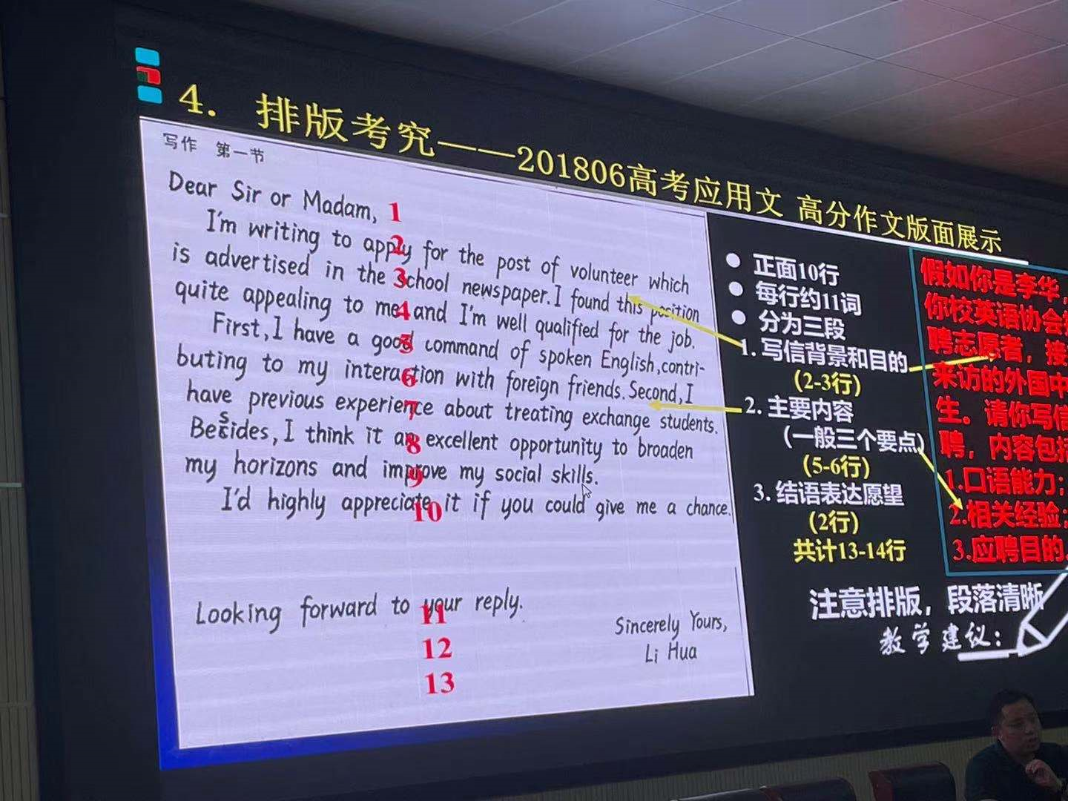

Slide 31
4.排版考究，2018年6月高考应用文高分作文版面展示
Dear Sir/Madam，
I am writing to apply for the post of volunteer advertised in the school newspaper. I found this position quite appealing and I am well qualified for the job.
First , I have a good command of spoken English, contributing to my interaction with foreign friends. Second, I have precious experience working as a volunteer for G20 so I can communicate with foreigners without any obstacle. Besides, I think it an excellent opportunity to broaden horizons and improve social skills.
I’d highly appreciate it if you could give me a chance. Looking forward to your reply.
Yours;
Li Hua
正面十行
每行约11词。分为三段。
1.写信背景和目的（2-3行）。2.主要内容
（一般三个要点）（5-6行）。3. 结束语表达愿望（2行）共计13到14行。注意排版，段落清晰
假如你是李华，你校英语协会招聘志愿者，接待来访的的外国中学生。请你写信应聘，内容包括:
1.口语能力;
2.相关经验; 3.应聘目的。

Slide 32
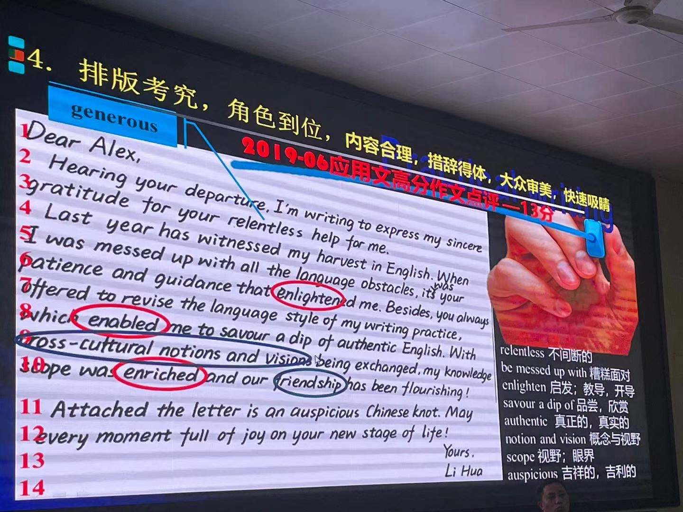

Slide 33
4. 排版考究，角色到位，内容合理，措辞得体，大众审美，快速吸睛。2019年6月应用文高分作文点评，13分
Dear Alex,
Hearing your departure, I'm writing to express my sincere gratitude for your relentless(不间断的) help for me.
Last year has witnessed my harvest in English. When I was messed up with all the language obstacles, its your patience and guidance that enlightened me. Besides, you always offered to revise the language style of my writing practice, which enab led me to savour a dip of authentic English knowledge. With cross-cultural notions and visions being exchanged, my knowledge scope was enriched and our friendship has been flourishing!
Attached to the letter is an auspicious（吉祥的) Chinese knot. May every moment full of joy on your new stage of life!
Yours,
Li Hua
1. relentless 不间断的
2. be messed up with 糟糕面对
3. enlighten启发;教育;开导
4.savor a dip of，品尝,欣赏
5. authentic 真正的;真实的
6. notion and version概念与视野
7.scope视野眼界
8.auspicious吉祥的;吉利的

Slide 34
3.合理拓展，语义连贯，彰显思维(9分中档作文评析)
Dear leader of school English Club,
I’m Li Hua who want to be an volunteer for greeting foreign friends. Delightful and excited, I jump and run, only wanting to thank you for your reading. As a confident student, I not only have great ability of English expression, but also I have passed CET six. Never in your widest dream had you thought that I ever took part in international English competition and won the champion. However, I am not satisfied with the success of the grades. Thus, I hope that I could join your club in order to improve my ability. Meanwhile, I also want to make contribution for the communication of China
Looking forward to your earliest reply.
Yours,
Li Hua
1.过多描述性语言，未能做到言筒意赅
2.不能切中要点

Slide 35
3.合理拓展，语义连贯，彰显思维(9分中档作文评析)
Dear leader of school English Club,
I’m Li Hua who want to be an volunteer for greeting foreign friends. Delightful and excited, I jump and run, only wanting to thank you for your reading. As a confident student, I not only have great ability of English expression, but also I have passed CET six. Never in your widest dream had you thought that I ever took part in international English competition and won the champion. However, I am not satisfied with the success of the grades. Thus, I hope that I could join your club in order to improve my ability. Meanwhile, I also want to make contribution for the communication of China
Looking forward to your earliest reply.
Yours,
Li Hua
1.过多描述性语言，未能做到言筒意赅
2.不能切中要点 3. 逻辑性较弱

Slide 36
3.合理拓展，语义连贯，彰显思维(优秀作品品析）
Dear Sir/Madam，
I am writing to apply for the post of volunteer advertised in the school newspaper. I found this position quite appealing and I am well qualified for the job.
First , I have a good command of spoken English, contributing to my interaction with foreign friends. Second, I have precious experience working as a volunteer for G20 so I can communicate with foreigners without any obstacle. Besides, I think it an excellent opportunity to broaden horizons and improve social skills.
I’d highly appreciate it if you could give me a chance. Looking forward to your reply.
在这篇习作中，作者采用了因果逻辑的思维方式合理拓展细节。
要点一 I am writing to apply 表结果（已知信息） I found this position 表原因（拓展信息），用因果逻辑关系展开写信目的，表达求职的迫切和真诚。
要点二 I have a good command of 表原因（已知信息）contributing to 表结果（拓展信息）用因果逻辑关系拓展口语能力的支撑细节，阐明口语所达到的能力水平。
要点三 I have precious experience of 表原因（已知信息） I can communicate with ，表结果（拓展信息）用因果逻辑关系拓展相关经验，进一证明交际能力
(2018年06月浙江高考)假如你是李华，你校英语协会招聘志愿者，接待来访的的外国中学生。请你写信应聘，内容包括: 1.口语能力;2.相关经验; 3.应聘目的。

Slide 37
3.合理拓展，语义连贯，彰显思维(优秀作品品析）
Dear Sir/Madam，
I am writing to apply for the post of volunteer advertised in the school newspaper. I found this position quite appealing and I am well qualified for the job.
First , I have a good command of spoken English, contributing to my interaction with foreign friends. Second, I have precious experience working as a volunteer for G20 so I can communicate with foreigners without any obstacle. Besides, I think it an excellent opportunity to broaden horizons and improve social skills.
I’d highly appreciate it if you could give me a chance. Looking forward to your reply.
在这篇习作中，作者采用了因果逻辑的思维方式合理拓展细节。
要点一 I am writing to apply 表结果（已知信息） I found this position 表原因（拓展信息），用因果逻辑关系展开写信目的，表达求职的迫切和真诚。
要点二 I have a good command of 表原因（已知信息）contributing to 表结果（拓展信息）用因果逻辑关系拓展口语能力的支撑细节，阐明口语所达到的能力水平。
要点三 I have precious experience of 表原因（已知信息） I can communicate with ，表结果（拓展信息）用因果逻辑关系拓展相关经验，进一证明交际能力
(2018年06月浙江高考)假如你是李华，你校英语协会招聘志愿者，接待来访的的外国中学生。请你写信应聘，内容包括: 1.口语能力;2.相关经验; 3.应聘目的。

Slide 38
3.合理拓展，语义连贯，彰显思维(优秀作品品析）
Dear Sir/Madam，
I am writing to apply for the post of volunteer advertised in the school newspaper. I found this position quite appealing and I am well qualified for the job.
First , I have a good command of spoken English, contributing to my interaction with foreign friends. Second, I have precious experience working as a volunteer for G20 so I can communicate with foreigners without any obstacle. Besides, I think it an excellent opportunity to broaden horizons and improve social skills.
I’d highly appreciate it if you could give me a chance. Looking forward to your reply.
。
衔接即“明承接”，通过连接词(比如本文中First ,Second, Besides等)将句子有机连接起来。
语义连贯指的是篇章的语义关联，是篇章的无形网络，存在于篇章的底层:衔接是篇章的一种语言显性特征，是篇章的有形网络，作者将这两种连接方式互相配合，娴熟使用，使全文文气通畅，读起来一气呵成。
(2018年06月浙江高考)假如你是李华，你校英语协会招聘志愿者，接待来访的的外国中学生。请你写信应聘，内容包括: 1.口语能力;2.相关经验; 3.应聘目的

Slide 39
3.合理拓展，语义连贯， 彰显思维(优秀作品评析)
To whom it may concern，
I’m LiHua.Learning you are recruiting volunteers to greet foreign students.I’m Writing for the position, with the purpose of improving my English level and accumulating experience.
Equipped with excellent spoken English, I’m sure I can meet with your essential requirements. Additionally, having served the community as a volunteer for two years,I have sufficient relevant experience, communication skills and teamwork spirit, which will enhance my confidence in the jo.
This being a precious opportunity to train myself I should be much a blind if you could consider me for that position your faithful
This being a precious opportunity to train myself, I shall be much obliged if you could consider me for the position.
最可贵的是作者神来之笔，自然地带出了应聘目的。逻辑清斯，层次分明，结构紧凑，简明现要。第三段结束语，虽是套话，但有套路， "This being a precious opportunity to train myself, I ” 大胆使用了独立主格结构，表达强烈愿望，但不失优雅风度。
(2018年06月浙江高考)假如你是李华，你校英语协会招聘志愿者，接待来访的的外国中学生。请你写信应聘，内容包括: 1.口语能力;2.相关经验; 3.应聘目的。

Slide 40
3.合理拓展，这 语义连贯， 彰显思维(优秀作品评析)
交际性拓展：借助语言支架，进行产出性思维表达。
写信目的/背景信息(角色代入,第一层级信息，第一段两行)
01状语，写作背景
02 I’m writing for / to... 写作体裁
03with the purpose of... /for... /to...
原因、目的、补充信息

Slide 41
3.合理拓展，语义连贯，彰显思维(优秀作品评析)
交际性拓展：借助语言支架，进行产出性思维表达。
写信目的/背景信息(角色代入,第一层级信息，第一段两行)
01
1. Learning you are recruiting volunteers to greet foreign students,
2. Hearing your departure.
3. Hearing your schedule to stay in China in the coming winter vacation,
4. Knowing that you’re really into learning Chinese /a lover of Chinese culture,
02
1. I'm writing for the position,(申请信)
2. I'm writing to express my sincere gratitude (感谢信)
3. l'm writing to extend my sincere invitation to you (邀清信)
4. I‘m writing to invite you to join in a Chinese Speech Contest (邀请告知信)
03
1. with the purpose of improving my English level and accumulating experience.
2. for your generous help.
3. to spend the Spring Festival with my family.
4. to be hoste in our school auditorium from 2:00pm to 5:00pm on Feb.6th.

Slide 43
4.排版考究，2018年6月高考应用文高分作文版面展示
Dear Sir/Madam，
I am writing to apply for the post of volunteer advertised in the school newspaper. I found this position quite appealing and I am well qualified for the job.
First , I have a good command of spoken English, contributing to my interaction with foreign friends. Second, I have precious experience working as a volunteer for G20 so I can communicate with foreigners without any obstacle. Besides, I think it an excellent opportunity to broaden horizons and improve social skills.
I’d highly appreciate it if you could give me a chance. Looking forward to your reply.
Yours;
Li Hua
正面十行
每行约11词。分为三段。
1.写信背景和目的（2-3行）。2.主要内容
（一般三个要点）（5-6行）。3. 结束语表达愿望（2行）共计13到14行。注意排版，段落清晰
假如你是李华，你校英语协会招聘志愿者，接待来访的的外国中学生。请你写信应聘，内容包括:
1.口语能力;
2.相关经验; 3.应聘目的。

Slide 45
4. 排版考究，角色到位，内容合理，措辞得体，大众审美，快速吸睛。2019年6月应用文高分作文点评，13分
Dear Alex,
Hearing your departure, I'm writing to express my sincere gratitude for your relentless(不间断的) help for me.
Last year has witnessed my harvest in English. When I was messed up with all the language obstacles, its your patience and guidance that enlightened me. Besides, you always offered to revise the language style of my writing practice, which enab led me to savour a dip of authentic English knowledge. With cross-cultural notions and visions being exchanged, my knowledge scope was enriched and our friendship has been flourishing!
Attached to the letter is an auspicious（吉祥的) Chinese knot. May every moment full of joy on your new stage of life!
Yours,
Li Hua
1. relentless 不间断的
2. be messed up with 糟糕面对
3. enlighten启发;教育;开导
4.savor a dip of，品尝,欣赏
5. authentic 真正的;真实的
6. notion and version概念与视野
7.scope视野眼界
8.auspicious吉祥的;吉利的

Slide 46
3. 捕捉原文伏笔 (隐喻/语义链)：前后呼应，形成亮点 (201806高考)
It was summer, and my dad wanted to treat me to a vacation like never before. He decided to take me on a trip to the Wild West.
We took a plane to Albuquerque, a big city in the state of New Mexico. We reached Albuquerque in the late afternoon. Uncle Paul, my dad’s friend, picked us up from the airport and drove us up to his farm in Pecos.
His wife Tina cooked us a delicious dinner and we got to know his sons Ryan and Kyle. My dad and I spent the night in the guestroom of the farm house listening to the frogs and water rolling down the river nearby. Very early in the morning, Uncle Paul woke us up to have breakfast. "The day starts at dawn on my farm," he said. After breakfast, I went to help Aunt Tina feed the chickens. while my dad went with Uncle Paul to take the sheep out to graze(吃草). I was impressed to see my dad and Uncle Paul riding horses. They looked really cool.
In the afternoon, I asked Uncle Paul if I could take a horse ride, and he said yes, as long as my dad went with me. I wasn’t going to take a horse ride by myself anyway. So, my dad and I put on our new cowboy hats, got on our horses, and headed slowly towards the mountains. "Don’t be late for supper," Uncle Paul cried, "and keep to the track so that you don’t get lost!" "OK! " my dad cried back. After a while Uncle Paul and his fam house were out of sight. It was so peaceful and quiet and the colors of the brown rocks, the deep green pine trees, and the late afternoon sun mixed to create a magic scene. It looked like a beautiful woven(编织的）blanket spread out upon the ground just for us.
以人物活动为接应点
—— 性格冲突、内心矛盾
I could picture Uncle Paul’s smiling face and our delicious supper and I thought to myself that our being lost added a special taste to my adventurous vacation which I would remember all my life.

Slide 47
4. 段句关联方式——主位推进，语义连贯（201806高考）
Suddenly a little rabbit jumped out in front of my horse. “What a lovely rabbit!” I shouted with eyes glittering with terrific excitement. It was quite different from those I saw in our city, thus immediately stimulating my interest. Dad was also stunned by this special rabbit/creature, gawking at it motionlessly. “Daddy, let’s catch it as our pet!” I suggested, unexpectedly receiving his prompt agreement. Entirely forgetting what Uncle Paul had told us, we chased after that pretty rabbit, frantic with rapture. Unfortunately, so clever and swift was it that it disappeared in the forest before long. Not until then did we realize that the last ray of twilight was quickly disappearing among the numerous trees and we couldn’t find our track at all! We did get lost!
We had no idea where we were and it was getting dark.

Slide 48
4. 段句关联方式——主位推进，语义连贯（201806高考）
We had no idea where we were and it was getting dark.
The river beside us was still and serene under the last ray of sunshine but we didn’t have the mood to enjoy it. Suddenly, it occurred to us that there was also a river nearby the farm house. Realizing the river may be a guide back, our spirits soared and we began to trot briskly along the river. Just a few minutes later, catching sight of the silhouette of the house, I felt a feeling of relief and relaxation surging through me. I could picture Uncle Paul’s smiling face and our delicious supper and I thought to myself that our being lost added a special taste to my adventurous vacation which I would remember all my life.

Slide 49
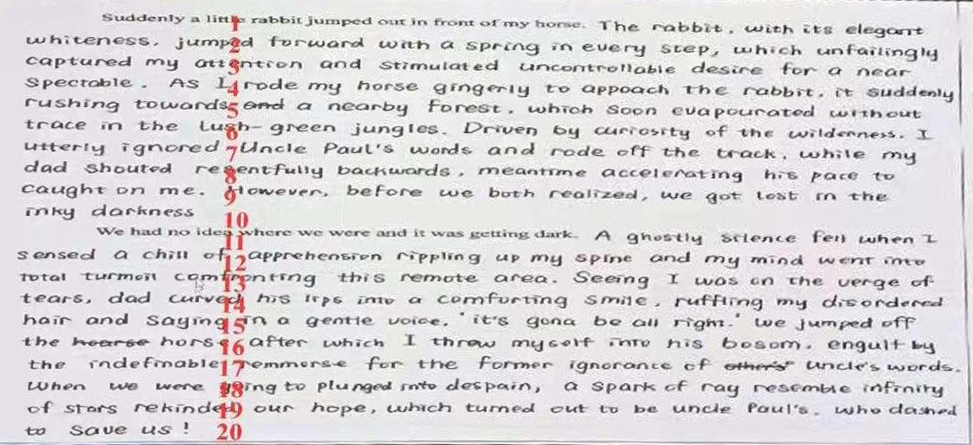
5. 续写高分卷展示（201806高考——23.5分）

Slide 50
5. 续写高分卷特点：工整书写，拒绝明显涂改，精细排版，字数无上限
印刷体（讨好体、交际体）
最后一行写至1/2处，适当留白
最后一行写至1/2处，适当留白

Slide 51
5. 阅卷四个敏感区(特别关注拼写、用词、高分开头、衔接、主题升华)
A 主位推进，高分开头
C 承上启下，严谨自然(打草稿)
B 主位推进，高分开头
D 语意连贯，主题升华(打草稿)

Slide 52
202101续写5档作文 深挖教材和考纲词汇的关联意义，赏析词汇的精妙，是实现语言协同的重要路径
I was stuck for five or six minutes though I felt much longer. Despite my unwillingness to admit it, I had made the most shameful and stupid mistake ever. I had no choice but to beg Jason to help me. He tried to pull it desperately, which only turned out in vain. Finally he decided to use a knife to break the pumpkin. Though he tried very cautiously and I didn’t get hurt actually, I felt unbearable fear crashed my mind, beads of sweat popping out on my forehead. Much to my dismay, my dad and mom whispered, giggled, chuckled and finally burst into laughter. After what seemed like a century, John managed to break the pumpkin. It was not until then that I found a camera just in front of me me. Worse still, my dad announced that the video would be shared online.
The video was posted online the Monday before Halloween. Reading the comments of audience and the world, I felt extraordinarily awkward and I was eager to melt into the ground. The number of “like” increased rapidly. I eventually couldn’t resist the temptation to watch it myself. So funny was that video that I couldn’t help laughing! With the video gaining more and more popularity, I felt a mixture of embarrassment and satisfaction striking into my heart. Just at that moment, Jason tapped on my shoulder, and admitted that I was the winner this year, followed by the applause of my whole family. “I won’t save you another time!” he laughed. Interesting as it was, I would never try this stupid thing anymore.
专家点评：情节、情感、语言、逻辑各方面都得到很好照顾，难得！与前文衔接紧密，感官和情感过渡自然。出南瓜前都是听觉、心理描写，或者是问题信息或者是主观判断，考虑周到。语言虽然有些不地道，但流畅通顺，无低级错误，描写细腻生动。（25分）

Slide 53
202101续写5档作文 情节主要靠动词推动，形成相同的语义场
I was stuck for five or six minutes though I felt much longer. Despite my unwillingness to admit it, I had made the most shameful and stupid mistake ever. I had no choice but to beg Jason to help me. He tried to pull it desperately, which only turned out in vain. Finally he decided to use a knife to break the pumpkin. Though he tried very cautiously and I didn’t get hurt actually, I felt unbearable fear crashed my mind, beads of sweat popping out on my forehead. Much to my dismay, my dad and mom whispered, giggled, chuckled and finally burst into laughter. After what seemed like a century, John managed to break the pumpkin. It was not until then that I found a camera just in front of me me. Worse still, my dad announced that the video would be shared online.
The video was posted online the Monday before Halloween. Reading the comments of audience and the world, I felt extraordinarily awkward and I was eager to melt into the ground. The number of “like” increased rapidly. I eventually couldn’t resist the temptation to watch it myself. So funny was that video that I couldn’t help laughing! With the video gaining more and more popularity, I felt a mixture of embarrassment and satisfaction striking into my heart. Just at that moment, Jason tapped on my shoulder, and admitted that I was the winner this year, followed by the applause of my whole family. “I won’t save you another time!” he laughed. Interesting as it was, I would never try this stupid thing anymore.
专家点评：情节、情感、语言、逻辑各方面都得到很好照顾，难得！与前文衔接紧密，感官和情感过渡自然。出南瓜前都是听觉、心理描写，或者是问题信息或者是主观判断，考虑周到。语言虽然有些不地道，但流畅通顺，无低级错误，描写细腻生动。（25分）

Slide 54
体会句法的精妙——名词动词是续写语言之基
1.伊丽莎白手里拿着玫瑰花，慢慢走向沃尔夫，舞台灯光灼热，汗珠顺着伊丽莎白的脸上滴下来。
Clutching the roses, Elizabeth walked slowly towards Ms. Wolf, the stage lights blazing hot nad beads of perspiration trickling down Elizabeth’s face.
现在分词作伴随状语

Slide 55
体会句法的精妙——名词动词是续写语言之基
1.伊丽莎白手里拿着玫瑰花，慢慢走向沃尔夫，舞台灯光灼热，汗珠顺着伊丽莎白的脸上滴下来。
Clutching the roses, Elizabeth walked slowly towards Ms. Wolff, the stage lights blazing hot and beads of perspiration trickling down Elizabeth’s face.
现在分词作伴随状语
两个独立柱格结构
在本句写作中，写作者创作了合适语境，准确适用非谓语动词(现在分词clutching作伴随状语，两个独立柱格结构lights blazing和perspiration trickling),能让写作句子更简洁，段落更紧凑，层次更分明。
并善用形容词性短语(beads of)、副词(slowly, hot)、介词短(towards down)，在关键处驻足，避免流水账，细化动作延缓过程，立体动感show出鲜活。

Slide 56
体会句法的精妙——名词动词是续写语言之基
2.沃尔夫女士优雅地走向钢琴，坐到座位上，然后开始弹琴。她的手指在琴键上翩翩起舞。她时而摇摆，时而点头，乌黑发亮的马尾辫跟着起伏摆动。她的双脚在踏板间来回穿梭。
MS. Wolff made her graceful way to the piano, took her seat and then began to play. Her fingers danced across the keys. She swayed and nodded, and her shiny black ponytail bobbed. Back and forth she raced her feet among the pedals.
三个并列谓语动词表一连串动作，说明舞台经验丰富，台风稳健
拟人
动作描写细腻真实，生动形象
非谓语动词的使用并非越多越好。Too much is a burden! “唯有动作描写，人物才能立起来”，动词和名词是描写动作性的根源。本段描写活用非谓语，动作描写精准传神，观察细致入微，灵活运用简单句，复合句以及其他多种多样的句式结构和修辞，才能让文章显得错落有致，有层次感。

Slide 57
体会课标单词的精妙——活用教材词汇，靶向高考写作
(运用能打动你的语言表达——去打动读者)
tick | vt. 给......标记号，发出滴答声
Time ticking away(独立柱格结构), mother hadn’t been home yet, making me worry about her. | 时间一分一秒过去了，母亲还没有回家，这使我很担心她。(续)
melt (melted; melted; melten) | vi. 融化；熔化；软化
1. The tension in the room began to melt. 2. Her trusting smile melted his heart. 3. When hearing these words, Scot felt his inner doubts/anxiety melt away. 4. The youths dispersed and melted into the darkness. | 1.屋里的紧张气氛开始缓和。(续) 2.她那信任的微笑使他的心变软了。(续) 3. 听到这些话，斯科特觉得内心的疑惑焦虑消失了。(续) 4. 年轻人们散开了，消失在夜色中。(续) disperse/dɪˈspɜːs/ v.分散；传播

Slide 58
5. 高考方向和预测——偏好体美，全面考察德智体美劳
年份 | 2016-10 | 2017-06 | 2017-11 | 2018-06 | 2018-11 | 2019-06 | 2020-01 | 2020-07 | 2020-07山东 | 2021-01
写作体裁 | 咨询信7.75 | 邀请信7.3 | 邀请信7.1 | 应聘信7.05 | 求助信7.3 | 感谢信7.85 | 邀请+告知信 | 慰问+告知信 | 新闻报道 | 欢迎辞
背景信息 | 作为交换生咨询情况 | 邀请外国朋友爬山 | 邀请外教到家过春节 | 应聘志愿者，接待国外学生 | 钱包遗失，向国际航空求助 | 对将回国的外国朋友表感谢 | 邀请外国朋友中文演讲比赛 | 外教因病回国休假，表慰问 | 为校英文报写报道，越野赛车活动 | 外国学生访问你校，致欢迎辞
体
体
高考预测 | 开展常见的跨文化交际或交流活动（老外）：语言学习，活动展开，人际交往，国际交流，参观访问考察较全面，偏好体美：全面考察德智体美劳，在巩固德育，坚守智育的基础上，加强对健康意识、审美情趣和劳动精神的考察，引导学生的全面发展。 16II邀请英国朋友为摄影展提供作品（美） 17III邀请留学生参加校乒乓球比赛（体） 18III回信告知英国朋友你校学生体育运动的情况（体） 19I申请到伦敦当地的美术馆当中国画展志愿者（美） 19II告知队友Chris排球队近期比赛信息（体) 19III邀请英国朋友参加校音乐节（美） 20I英语作文比赛“身边值得尊敬和爱戴的人”（简介和原因）（德） 20II为班级英语角介绍农场采摘活动（农场情况，采摘过程，个人感受）（体） 20III求助外教帮忙指导英语课文改编（剧情简介；指导内容；商定时间地点）（文学语言） 20年新高考卷（山东）为校英文报写新闻报道；越野赛跑活动（体）

Slide 59
5. 高考方向和预测——偏好体美，全面考察德智体美劳
年份 | 2016-10 | 2017-06 | 2017-11 | 2018-06 | 2018-11 | 2019-06 | 2020-01 | 2020-07 | 2020-07山东 | 2021-01
写作体裁 | 咨询信7.75 | 邀请信7.3 | 邀请信7.1 | 应聘信7.05 | 求助信7.3 | 感谢信7.85 | 邀请+告知信 | 慰问+告知信 | 新闻报道 | 欢迎辞
背景信息 | 作为交换生咨询情况 | 邀请外国朋友爬山 | 邀请外教到家过春节 | 应聘志愿者，接待国外学生 | 钱包遗失，向国际航空求助 | 对将回国的外国朋友表感谢 | 邀请外国朋友中文演讲比赛 | 外教因病回国休假，表慰问 | 为校英文报写报道，越野赛车活动 | 外国学生访问你校，致欢迎辞
文化活动
文化活动
文化活动
文化活动
高考 预测 | 1. 开展常见的跨文化交际或交流活动（老外）：语言学习，活动展开，人际交往，国际交流，参观访问 2.未来话语，中国梦的话语建构：融入中华传统文化，体现跨文化交际，重视培育学生中国情怀和国际视野，鼓励其“用英语讲好中国故事，传播优秀传统文化。” 19全国I申请到伦敦当地美术馆当中国画展志愿者 18全国I告知新西兰朋友在中国家庭做客的基本习俗 17全国I告知英国朋友下次学习汉语课（唐诗）计划 17全国II邀请外教参加中国剪纸艺术展
回避政治敏感话题；
促进中外文化交流

Slide 60
5. 高考方向和预测——未来话语，中国梦的话语建构
During your visit, we will do a lot of interesting things together, including watching kungfu, visiting a tea museum, learning ink painting, and trying different kinds of Chinese food. We will also take you to an ancient town, where you will learn about the local culture. Finally we really look forward to interacting with you and wish you have a good time here.(考试中心范文）
假如你是李华，下周新西兰学生访问你校，你将作为学生代表致欢迎词。请为此写一篇发言稿，内容包括：
1.表示欢迎；
2.介绍活动安排；3.表达祝愿（2021年1月浙江高考-致欢迎词）
After the welcome meeting, we will show you around the school so that you can be more familiar with it.Then you will attend a Chinese class where you can savour a dip of the beauty of Chinese. At noon, you can enjoy some traditional Chinese delicacies.The following hours you will experience paper cutting, exploring the magic of Chinese art.(14分样卷）

Slide 61
5. 高考方向和预测——偏好体美，全面考察德智体美劳
年份 | 2016-10 | 2017-06 | 2017-11 | 2018-06 | 2018-11 | 2019-06 | 2020-01 | 2020-07 | 2020-07山东 | 2021-01
写作体裁 | 咨询信7.75 | 邀请信7.3 | 邀请信7.1 | 应聘信7.05 | 求助信7.3 | 感谢信7.85 | 邀请+告知信 | 慰问+告知信 | 新闻报道 | 欢迎辞
背景信息 | 作为交换生咨询情况 | 邀请外国朋友爬山 | 邀请外教到家过春节 | 应聘志愿者，接待国外学生 | 钱包遗失，向国际航空求助 | 对将回国的外国朋友表感谢 | 邀请外国朋友中文演讲比赛 | 外教因病回国休假，表慰问 | 为校英文报写报道，越野赛车活动 | 外国学生访问你校，致欢迎辞
非书信
高考预测 | 开展常见的跨文化交际或交流活动（老外）：语言学习，活动展开，人际交往，国际交流，参观访问考察较全面，偏好体美：全面考察德智体美劳，在巩固德育，坚守智育的基础上，加强对健康意识、审美情趣和劳动精神的考察，引导学生的全面发展。 16II邀请英国朋友为摄影展提供作品（美） 17III邀请留学生参加校乒乓球比赛（体） 18III回信告知英国朋友你校学生体育运动的情况（体） 19I申请到伦敦当地的美术馆当中国画展志愿者（美） 19II告知队友Chris排球队近期比赛信息（体) 19III邀请英国朋友参加校音乐节（美） 20I英语作文比赛“身边值得尊敬和爱戴的人”（简介和原因）（德） 20II为班级英语角介绍农场采摘活动（农场情况，采摘过程，个人感受）（体） 20III求助外教帮忙指导英语课文改编（剧情简介；指导内容；商定时间地点）（文学语言） 20年新高考卷（山东）为校英文报写新闻报道；越野赛跑活动（体）
1.邀请信和告知信备受命题者喜爱
2.五年内未考：建议信；道歉信；祝贺信；通知
发言稿 投诉信？（演讲？欢迎 欢送）

Slide 62
6.应用文考前30天备考策略——熟能生巧，胸有成竹
典型主题活动时间、地点、主题、内容的重点记忆（10个）
1）文化交流中个人特长或志愿者的自荐、推荐、招聘
2）旅行或文体活动求助、建议、致歉、感谢
3）户外活动、环保或劳动报道、邀请
4）学校（跨文化）文化活动或志愿者活动的邀请、通知
5）传统文化活动交流中国画展、剪纸、唐诗宋词的告知安排......
假定你是李华，你的新西兰朋友Leo准备来中国学习，他来信向你咨询有关学习汉语的建议。请用英语给他写一封回信。内容包括：1.表示欢迎 2.提出建议 3.表达期待(2020学年第二学期五校联考试题 学军中学）
假如你是李华，你的英国笔友Tom 准备拍摄一个“Hello, China”的短视频，他写信请你帮忙策划主题，使视频更好地体现中国元素。请你用英文写一封回信，内容包括：1.拍摄主题 2.推荐原因3.表达祝愿（2021年5月嵊州二模）

Slide 63
6.应用文考前30天备考策略——熟能生巧，胸有成竹
审题的专项训练
1）4个要点（合理拓展，语意连贯，彰显思维）
2）共情能力，角色代入，内容要点服从于角色
3）格式不能出错，时间地点的表达
4）跨文化意识，传播中华文化的能力
5）体现社会主义核心价值观的新课标”立德树人“的育人目标

Slide 64
6.应用文考前30天备考策略——熟能生巧，胸有成竹
称呼语、开头、结尾和落款的套路
信件邮件：
熟悉的朋友（Dear+first name)但要注意的是， “Mr/Ms.+名字”是不规范的写法，不应该使用Mr. Jason或 Ms. Sara
Dear James/Sara,
第一次发邮件联系对方（最为妥当的方式使用“Dear Mr./Ms. +对方姓氏family name.不知道已婚或者未婚的女士，一律用Ms. 最为稳妥）
Dear Mr Bennet/Ms white/Miss Ellis,
不知道对方的姓名（但知道对方的头衔、身份，使用 “Dear +title”来称呼对方，这样也显得非常礼貌）
Dear Teacher/Editor/Headmaster/Manager,
至相关人员、敬启者、致有关人士（无法确定对方身份和具体称呼时候才使用）
Dear Sir or Madam,
To whom it may concern,

Slide 65
6.应用文考前30天备考策略——熟能生巧，胸有成竹
称呼语、开头、结尾和落款的套路
致词
Good evening, dear teachers and fellow students!
Dear American friends,/Dear fellow students,/Ladies and gentleman.
招聘信
Volunteer wanted
书面通知
Notice
口头通知
Announcement
Hello,everybody/everyone./Ladies and gentleman.May I have your attention, please? I have an announcement to make.
海报
English Corner, Learner’s Garden

Slide 66
应用文考前30天备考策略——熟能生巧，胸有成竹
称呼语、开头、结尾和落款的套路
书面通知
The Students’ Union
October 10, 2020
信件邮件：
Yours respectfully, 此致敬礼
Li Hua 写给长辈上级
Yours cordially/faithfully/genuinely, 真诚的/热忱的/忠诚的
Li Hua 写给商务/平辈朋友

Slide 67
八次高考读后续写：对比分析
考试时间 | 2016.10 | 2017.06 | 2017.10 | 2018.06 | 2020.01 | 2020.07 | 2020.07（山东） | 2021.01
主旨大意 | 丛林逃生 | 狼口脱险 | 健忘妈妈旅行记 | 父子寻路 | 为狗找伴 | 和北极熊面对面 | 度过经济难关 | 南瓜卡头
篇章结构 | 问题-解决 | 问题-解决 | 概括-具体 | 问题-解决 | 问题-解决 | 问题-解决 | 问题-解决 | 问题-解决
 | “冲突-危机-解决模式”是读后续写常见的叙事结构
主题语境 | 人与自然 | 人与自然 | 人与社会 | 人与自然 | 人与社会 | 人与自然 | 人与社会 | 人与社会
场景特点 | 丛林、直升机、外套 | 夏日下午、自行车、汽车等 | 开车旅行探亲、沿途风光 | 农场、河流、兔子、骑马 | 人与狗的互相陪伴 | 营地、直升机、相机 | 经济危机、社区、爆米花 | 厨房、相机
情感态度 | 亲情 | 友情 | 亲情 | 亲情 | 亲情 | 亲情 | 亲情 | 人间真情
思维特点 | 平衡限定性与开放性、逻辑思维与创造性思维、理顺与顺理的关系

Slide 68
1. 构建写作支架- “点线面”快速构思法（202007高考）
①时空线（明线） |  | ②情节线（明线） | ③情感线（暗线）
时空：fall空间：a research camp |  | 人物：Elli I;polar bear事物：pictures，camera,bread,fence,noises,spray动作：photograph,ran | 情感态度价值观：safe
问题链 | 第一段 | A few minutes later,the bear headed back to our camp. How did the bear feel after being sprayed? What actions would the bear take? How did my wife Elli and I feel and what danger had we encountered?
 | 第二段 | At that very moment, the helicopter arrived. What responses would the bear make to the helicopter? Where Elli and I rescued?How did we feel then?
呼应点 |  | Taking pictures of polar bear is amazing but also dangerous.

Slide 69
2. 解读叙事元素，推进情节逻辑（202001高考）
components
implant
composition
故事背景 setting 人物性格 personal character
implant
冲突 conflict 铺垫 foreshadowing
悬念 suspense 首尾呼应 inclusio
理顺叙事元素，顺理协同成章
叙事元素
component
composition

Slide 70
2. 解读叙事元素，推进情节逻辑（202001高考）
故事背景 setting
out of town to the university
He bent down to hug his old friend goodbye. He stood up, hugged his parents, and smiled, trying not to let his emotions get the better of him…The family hugged and smiled through misty eyes and then laughed. (It’s a family full of love)
人物性格
personal character
冲突 conflict
The house seemed quiet as a tomb without the boy living there.
The old girl just wasn’t her usual cheerful self.
铺垫 foreshadowing
“I’m going to miss you so much, Poppy”
情节发展方向明确
悬念 suspense
“I have an idea, but it might be a little crazy.”
首尾呼应 inclusio
Her owners were sad too, but they knew their son would be back to visit.
Poppy didn’t.
主题明确，逻辑严谨

Slide 71
2. 解读叙事元素，推进情节逻辑（202007高考）
one fall; a research camp outside “the polar bear capital of the world”, a
single goal (to photograph polar bears)
故事背景 setting
人物性格
personal character
Elli and I: love adventure and photography
the polar bear: hungry
冲突 conflict
Sometimes loud noises like these will scare bears off. Not this polar bear
though.
But sometimes, that is easier aid than done. This was one of those times.
铺垫 foreshadowing
情节发展方向明确
I radioed the camp manager for help. He told me a helicopter was on its
way, but it would be 30 minutes before it arrived.
悬念 suspense
首尾呼应 inclusio
Taking pictures of polar bears is amazing bur also dangerous.
主题明确，逻辑严谨

Slide 72
怎么“续”？拉波夫（Labov, 1927）关于叙事结构的分析模式
点题
叙述者在叙述故事前对故事的简要概括。
叙述者在故事的开始对时间，地点，人物及其活动或环境
的描述。(铺垫）
指向
进展
故事本身的发生，事态的发展。
一系列事件的结束，故事的结果或结局，包括人物的下场，目的的
实现或失败等。
结局
回应
在故事的结尾，用一两句话来接应主题，使听者对叙述有一个完整
的了解，对故事有一个有头有尾的满意感。
叙述者对故事发生的原因，故事的要点，叙述故事的目的，动作或
人物等的评论。也可表达叙述者对某种情况的看法，态度。评议可
用来制造悬念，增强故事的吸引力和感染力。
评议
一个完整的叙述的开始点是指向，接着是进展，然后是结局，最后是回应，评议渗透在进展和结局之中。当然，
并不是所有的叙事结构都包括上述完整的六个部分。

Slide 73
浙江和山东读后续写：对比分析
浙江
山东
启示
1. 增加读的难度
2. 语言协同难度加大，语义连贯
（语义链）要求更高
划线词
10个
无
阅读下面短文，根据所给情节
进行续写，使之构成一个完整
的故事。
阅读下面材料，根
据其内容和所给段
落开头语续写两段，
使之构成一篇完整
的短文。
1. 可以有议论，夹叙夹议（叙述者
对故事发生的原因，故事的要点，
叙述故事的目的，动作或人物等的
评论）
2. 语篇概要能力
题目要求
1. 所续写短文的词数应为150
左右
2. 至少使用5个短文中标有下
划线的关键词语；
3. 续写部分分为两段，每段的
开头语已为你写好；
4. 续写完成后，请用下划线标
出你所使用的关键词语。
1. 续写词数应为150
左右；
2. 请按如下格式在
答题卡的相应位置
作答。
1. 没有形式上的语意连贯；
2. 但要注意培养语篇分析能力和
熟练掌握读写全过程的衔接与连
贯手段。
注意

Slide 74
3. 捕捉原文伏笔（隐喻/语义链）——前后呼应，形成亮点
Appealing endings?
1）以人物活动为接应点
—— 性格冲突，内心矛盾
合情合理，出人意料
寓情于景，情景交融
这只悬念，留白想象
合理推断，拔高立意
情感真挚，激发共鸣
2）以情节发展为接应点
—— 矛盾悬念，有效解决
3）以环境描写为接应点
—— 环境相同，心境不同
1. 深谙隐喻之道，读懂言外之意；
2. 语义链的末端就是神经末梢，撩拨心弦，自然舒畅，
无需名言警句，脱离语境的高大上。

Slide 75
3. 捕捉原文伏笔（隐喻/语义链）——前后呼应，形成亮点
1）以人物活动为接应点—— 性格冲突，内心矛盾
原文首段：I had an interesting childhood: It was filled with surprise and amusements,
all because of my mother-loving, sweet, and yet absent-minded and forgetful. One
strange family trip we took when I was Eleven tells a lot about her.
(2017年11月浙江省高考试题读后续写）
续写：This trilling, memorable trip reminded every now and then that Mom was not all
about an absent-minded, forgetful person, but was someone who was fully aware of how
to add color to daily life. It dawned on me that once we explored, life would embrace you.
由反求正，反弹琵琶，既回扣全文，又通过与健忘妈妈旅行，人物形象反转：妈妈是
一位能给我们带来多彩的生活，教会我们人生道理。

Slide 76
3. 捕捉原文伏笔（隐喻/语义链）——前后呼应，形成亮点
1）以人物活动为接应点—— 性格冲突，内心矛盾
原文首段: “I’m going to miss you so much, Poppy, ”said the tall, thin teenager. He bent down to hug his olf friend goodbye. He stood up, hugged his parents and smiled, trying not to let his emotions get the better of him.
(2017年11月浙江省高考试题读后续写）
续写：The boy beamed while patting both dogs: “I don’t know if I should feel thrilled for having a new puppy or sad because Poppy had found a new best friend!”
由表及里，对男孩子来说“Poppy 找到新朋友是喜是忧”，思考离别的意义，反映内心的触动和成长。

Slide 77
3. 捕捉原文伏笔（隐喻/语义链）——前后呼应，形成亮点
2）以情节发展为接应点 —— 矛盾悬念，有效解决
原文首段: One fall, my wife Elli and I had a single goal: to photograph polar
bears. We were saying at a research camp outside “the polar bear capital of the world”-the town of Churchill in Manitoba, Canada.
（2020年7月浙江省高考试题读后续写）
续写：After we calmed down, the locals told us that the bears were losing their homes and food because of human activities and climate changes. On the way back home, I checked the precious pictures in the camera, lost in thought.
由一及重， 由个人个人经历及“a single goal”联系“人类活动对动物生存环境的负面影响”，紧扣主题适当呼吁，升华到“环境保护”大主题。

Slide 78
3. 捕捉原文伏笔（隐喻/语义链）——前后呼应，形成亮点
2）以情节发展为接应点 —— 矛盾悬念，有效解决
原文首段: The Meredith family lived in a small community. As the economy was in decline, some people in the town had lost their jobs. Many of their families were struggling make ends meet. People were trying to help each other meet the challenges. （2020年7月山东省高考试题读后续写）
续写：Although it was a hard time and people were tightening their belts, Bernard’s business worked out quite well and everyone was ready to buy one pack to support him. … It turned out that their efforts not only helped a brother in need, but also gave themselves the sweet taste of helping others.
由事及理， 由“帮助小男孩卖爆米花”讲述“只要乐于助人，就总有办法摆脱困境，且内心幸福”的道理，起到画龙点睛，传递正能量的效果。

Slide 79
3. 捕捉原文伏笔（隐喻/语义链）——前后呼应，形成亮点
3）以环境描写为接应点—— 环境相同，心境不同
原文首段: As Mac pedaled along alone, he thought fondly of his wife and two young daughters at home. He hoped to show them this beautiful place someday. （2017年6月山东省高考试题读后续写）
续写：On the way home, night breeze made him at ease and he couldn’t wait to share his experience with his wife and daughters and show the kindness of the world.
由点到面，呼应首段，并使主题的境界得到提升“分享经历传播正能量和互帮互助人间大爱”。

Slide 80
3. 捕捉原文伏笔（隐喻/语义链）——前后呼应，形成亮点
3）以环境描写为接应点—— 环境相同，心境不同
原文首段: Five years ago, I had a nine-to-five job, and I usually commuted（通勤）to work by bus. Those long tiring hours of traveling were always annoying. But one day, it was healing.（2021年3月浙江省名校写作题读后续写）
续写：The woman took some cheese bread to the old man and said “Don’t worry. All is going well.” It amazed me that what random actions of kindness could mean to the people who received it. From that day I was not annoyed
At the long tiring hours of traveling home any more. I felt healed, enjoying every moment commute to work.
由此及彼，尽管捉襟见肘，左支右绌，遭遇偷窃，经历痛苦和挣扎，该妇女依然相信善良，相信世间温情，释放着温暖和善意，她也用这份温情完成了自我救赎，治愈healing世人（包括作者）。

Slide 81
体会课标单词的精妙---活用教材词汇,靶向高考写作
（运用能打动你的语言表达—去打动读者）
13.make one’s way 前往;克服困难艰难地或想方设法去某地
1. There being a big flood独立主格结构， the rescue team still made their way to the disaster area. 2.fight/ nudge /feel /wind /crack /inch one’s way | 1.尽管发生了大洪水， 但救援队仍然艰难地向灾区进发。（续） 2.努力辟出一条路挤进；推进；摸索着前进；蜿蜒而行；艰难地进入；慢慢前行（续）
nudge [nʌdʒ] vt.（用肘）轻推

Slide 82
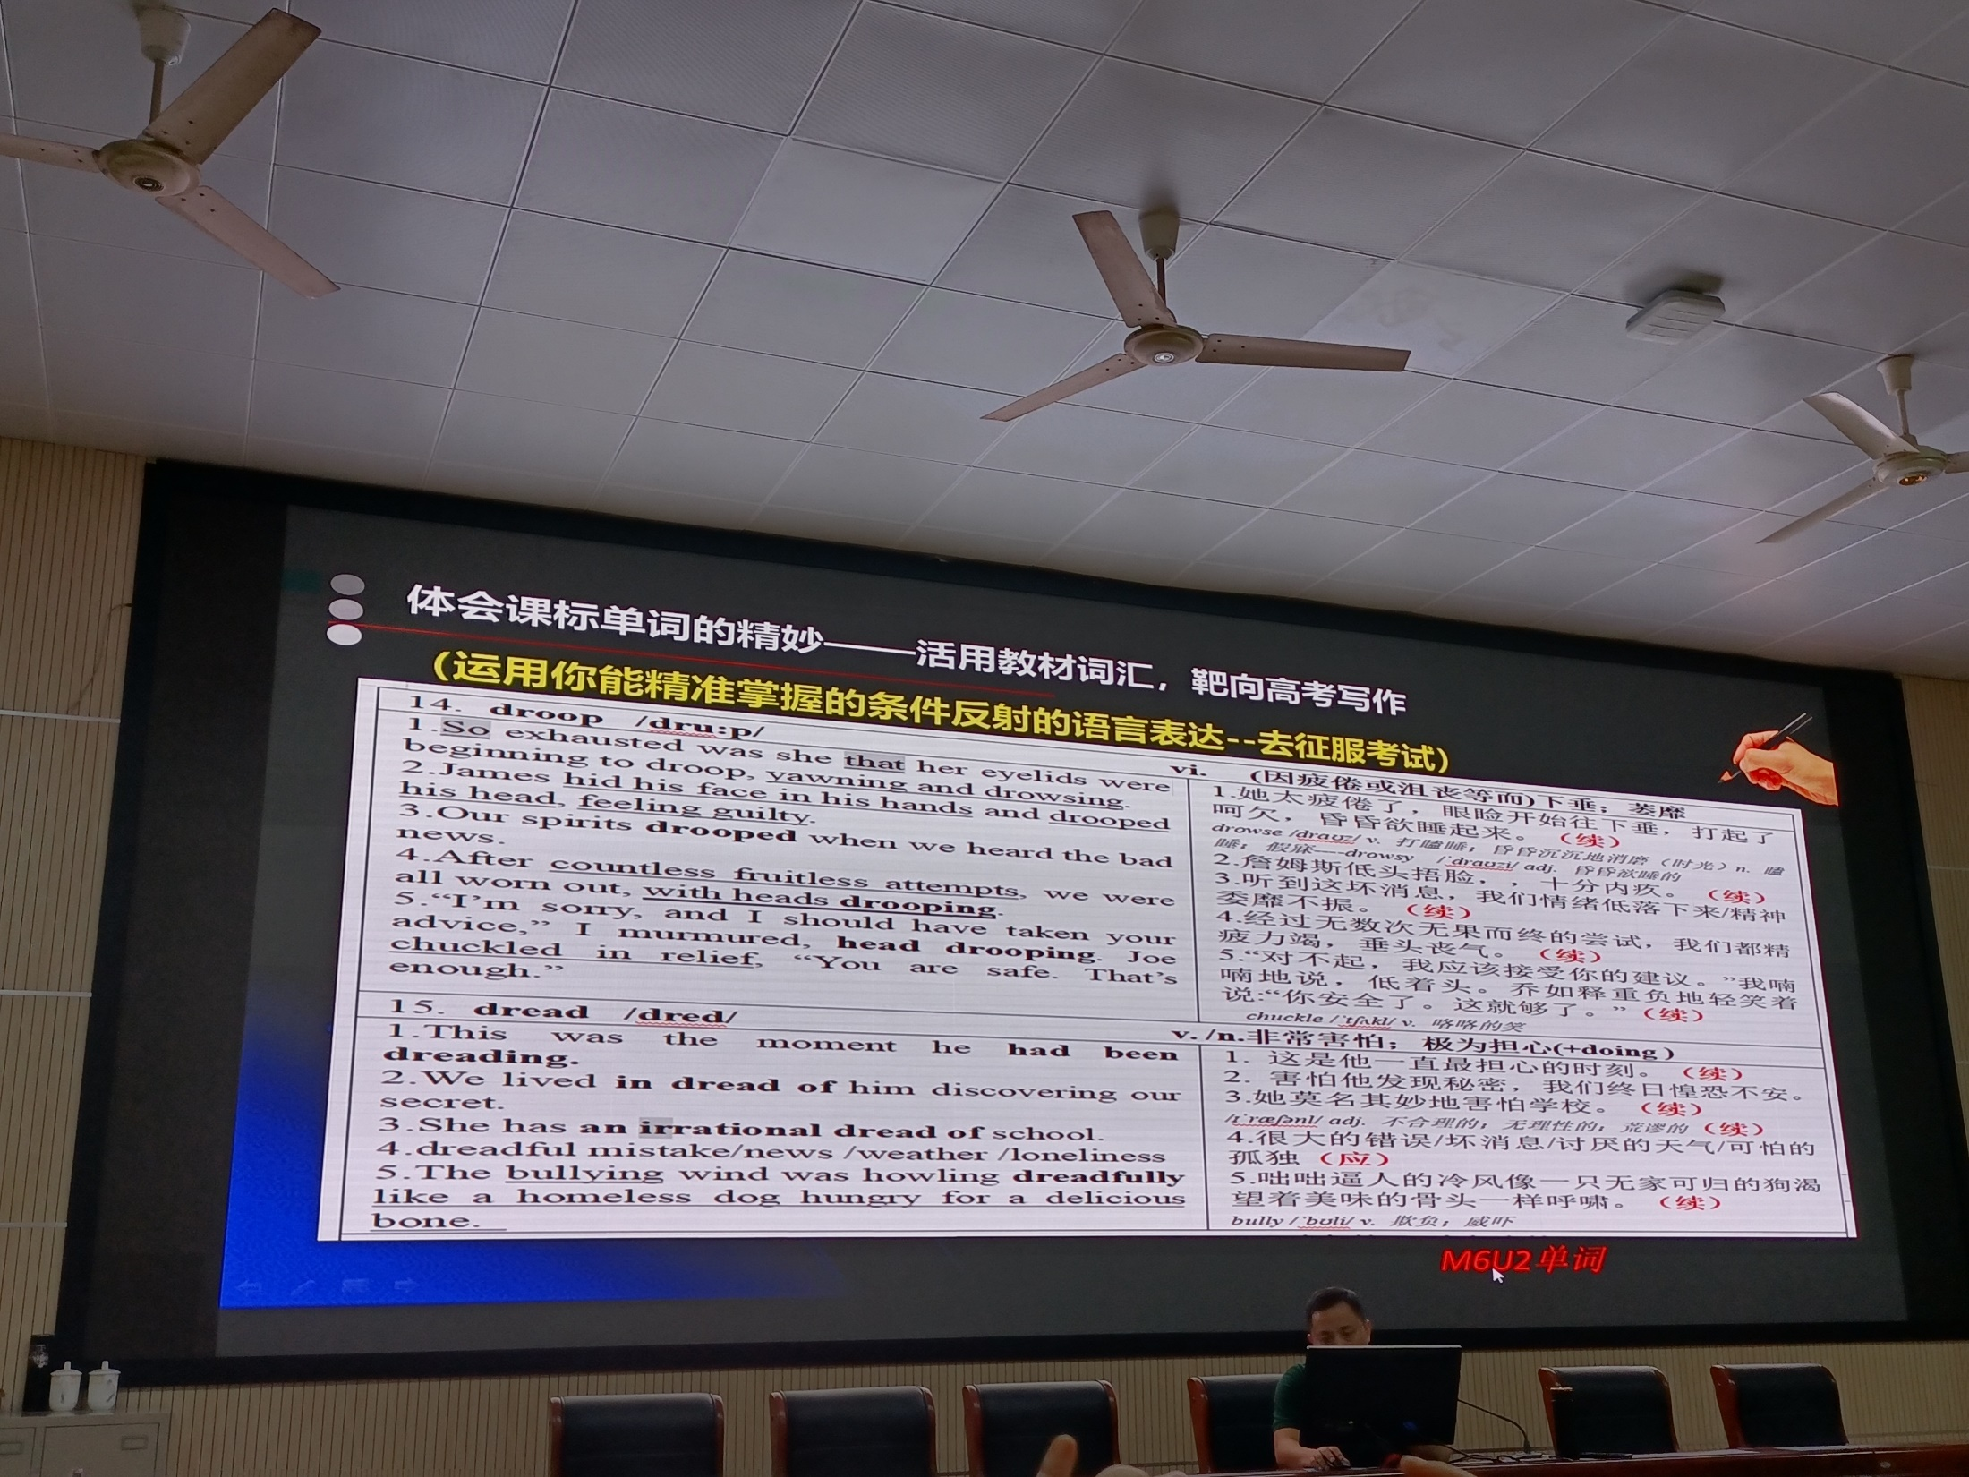

Slide 83
体会课标单词的精妙---活用教材词汇，靶向高考写作
（运用你能精准掌握的条件反射的语言表达--去征服考试）
14.droop vt.(因疲惫或沮丧等而）下垂，萎靡
1.So exhausted was she that her eyelids were beginning to droop, yawning and drowsing. 2.Janes hid his face in his hands and drooped his head, feeling guilty. 3.Our spirits drooped when we heard the bad news. 4.After countless fruitless attempts, we were all won out , with heads drooping. 5.“I'm sorry, and I should have taken your advice .” I murmured, head drooping. Joe chuckled in relief. “You are safe. That’s enough.” | 1.她太疲倦了，眼险开始往下垂，打起了呵欠，昏昏欲睡起来。（续） drowse[drauz]v.打瞌睡,昏昏沉沉地消磨(时光)n.瞌睡,假寐--drowsy adj.昏昏欲睡的 2.詹姆斯低头捂脸十分内疚. (续） 3.听到这坏消息，我们情绪低落下来/精神委靡不振。(续） 4.经过无数次无果而终的尝试，我们都精疲力竭，垂头丧气。(续） 5.“对不起,我应该接受你的建议.”我喃喃地说，低着头。乔如释重负地轻笑着说， “你安全了。这就够了。” (续） Chuckle v.咯咯的笑
15.dread v/n.非常害怕，极为担心（+doing）
1.This was the moment he had been dreading. 2.We lived in dread of him discovering our secret. 3.She has an irrational dread of school. 4.dreadful mistake/news /weather /loneliness 5.The bullying wind was howling dreadfully like a homeless dog hungry for a delicious bone. | 1.这是他一流最担心的时刻。(续） 2.善怕他发现秘密，我们终日惶恐不安（续） 3.她莫名其妙地害怕学校。（续）irrational不合理的,无理性的,荒谬的 4.很大的错误/坏消息/讨厌的天气/可怕的孤独（续） 5.出咄逼人的冷风像一只无家可归的狗渴望着美味的骨头一样呼啸。（续） bully v.欺负,恐吓

Slide 84
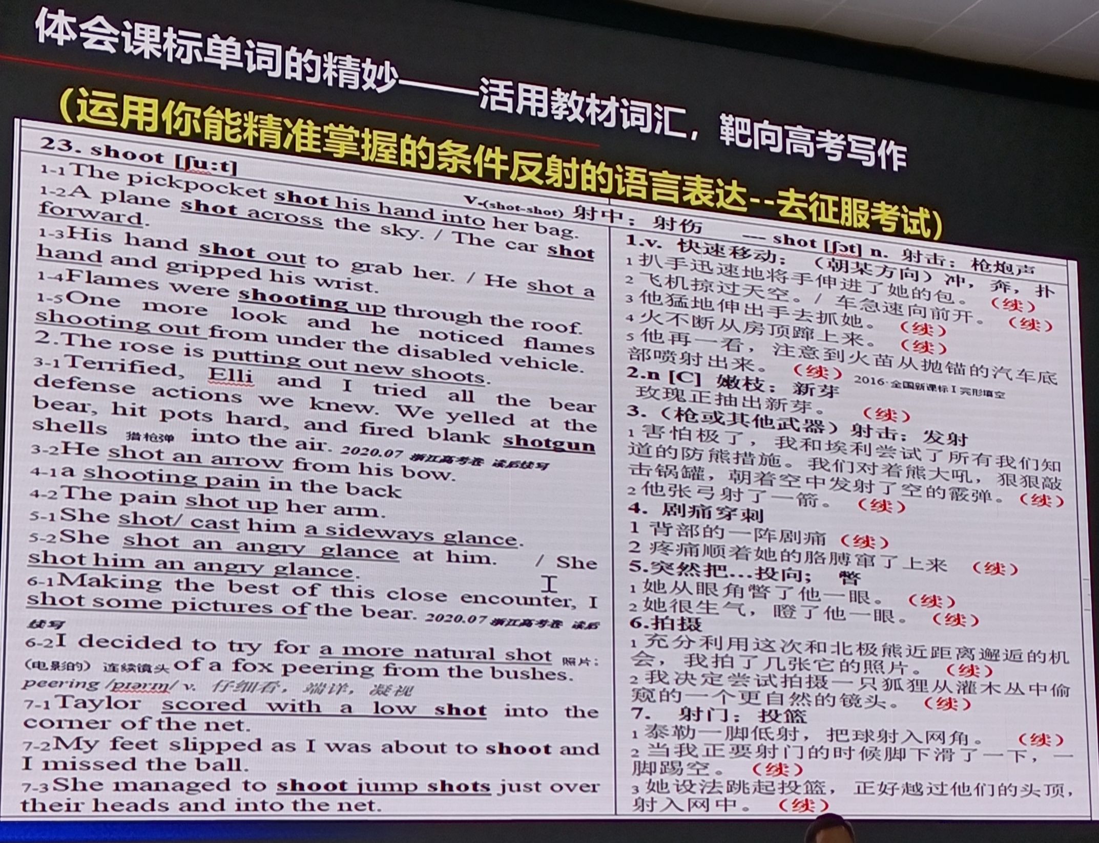

Slide 85
体会新课标单词的精妙—活用教材词汇,靶向高考写作
(请运用你能精准掌握的条件反射的语言表达—去征服考试)
23.shoot v.(shot, shot) 射中;射伤 shot n. 射击;枪炮声
1-1 The pickpocket shot his hand into her bag. 1-2 A plane shot across the sky./ The car shot forward. 1-3His hand shot out to grab her. / He shot a hand and gripped his wrist. 1-4Flames were shooting up through the roof. 1-5One more look and he noticed flames shooting out from under the disabled vehicle. 2.The rose is putting out new shoots. 3-1Terrified, Elli and I tried all the bear defense actions we knew. We yelled at the bear, hit pots hard, and fired blank shotgun shells猎枪弹 into the air. 2020.07 高考卷 续写 3-2He shot an arrow from his bow. 4-1a shooting pain in the back 4-2 The pain shot up her arm. 5-1She shot/ cast him a sideways glance. 5-2She shot an angry glance at him./She shot him an angry glance. 6-1Making the best of this close encounter, I shot some pictures of the bear.2020.07浙江高考卷读后读写 6-2 I decided to try for a more natural shot 照片; (电影的) 连候镜头of a fox peering from the bushes. peering v.仔细看，端详，凝视 7-1Taylor scored with a low shot into the corner of the net. 7-2My feet slipped as I was about to shoot and I missed the ball. 7-3 She managed to shoot jump shots just over their heads and into the net. | 1.v.快速移动;（朝某方向）冲,奔,扑 1扒手迅速地将手伸进了她的包。(续) 2飞机掠过天空./车急速向前开。(续） 3他猛地伸出手去抓她。 (续） 4火不断从房顶踪上来。 (续） 5他再一看，注意到火苗从抛锚的汽车底部喷射出来.(续) 2016全国新课标I完形 2.n[C]嫩枝：新芽 玫瑰正抽出新芽。 （续） 3、（枪或其他武器）射击： 1害怕极了，我和埃利尝试了所有我们知道的防熊措施。我们对着熊大吼，狠狠敲击锅罐，朝着空中发射了空的霰弹。（续） 2他张弓射了一箭。（续） 4.剧痛穿刺 1背部的一阵剧痛（续） 2疼痛顺着她的胳膊窜了上来（续） 5.突然把...投向；瞥 1她从眼角瞥了他一眼。(续) 2她很生气，瞪了他一眼。(续) 6.拍摄 1充分利用这次和北极熊近距离迎近的机会，我拍了几张它的照片（续） 2我决定尝试拍摄一只狐狸从灌木丛中偷窥的一个更自然的镜头（续） 7.射门：投篮 1泰勒一脚低射,把球射入网角（续） 2当我正要射门的时候脚下滑了一下，一脚踢空。 （续） 3她设法跳起投篮,正好越过他们的头顶,射入网中。（续）

Slide 86
6.读后续写的语言技巧--准确定位
尖子生:神形兼备炫出彩(23分),语言丰富,情节合理,逻辑严密,
传神的语言提亮表达方式,前后呼应耐人寻味.
中等生:稳扎稳打有亮点(20分),语言规范,线索清晰,逻辑合理,
精当的语言推进情节发展,起承转合一气呵成.
拐脚生:降低门槛求完整(15分),粗线条,重印象(书写)
准确的语言叙述完整故事,在情在理通达顺畅.

Slide 87
6.读后续写备考策略—胸有成竹
二考特点:经验教足,准确定位,多种预案(确保20+30分钟写作)
续写考前30天:语言(①语料库的熟练准确运用,浓缩
读薄,能驾驭,快产出,零失误.;
②真实的语料co-text(上下文),
实际发生时的语境含义
③动词四式,过去时的各种时态)
情节(叙事元素,逻辑衔接,思想共鸣)
王初明教授指出高考中的读后续写考题的短板在于互动教弱,提出要“内容引领语言使用”,在完全理解原文基础上进行续写,不断地参照对比原文,以拉平和作者之间的差距.

Slide 88
其他备考建议:
1.回归真题,命题意识(学会出题)
2.关注山东新高考和本次首考
3.高频词汇(完形填空)
4.作文自评和互评(自我评价Self-assessment+同
伴互评peer-assessment)
5.限时训练,应试技巧,考试节奏(21分钟阅读,
25分钟七选五+完形的精准和熟练)
6.抢抓书写
7.分层指导和教学
8:理论提升:
语篇分析理论(语义链/场)
主位推进
修辞(隐喻)

Slide 89
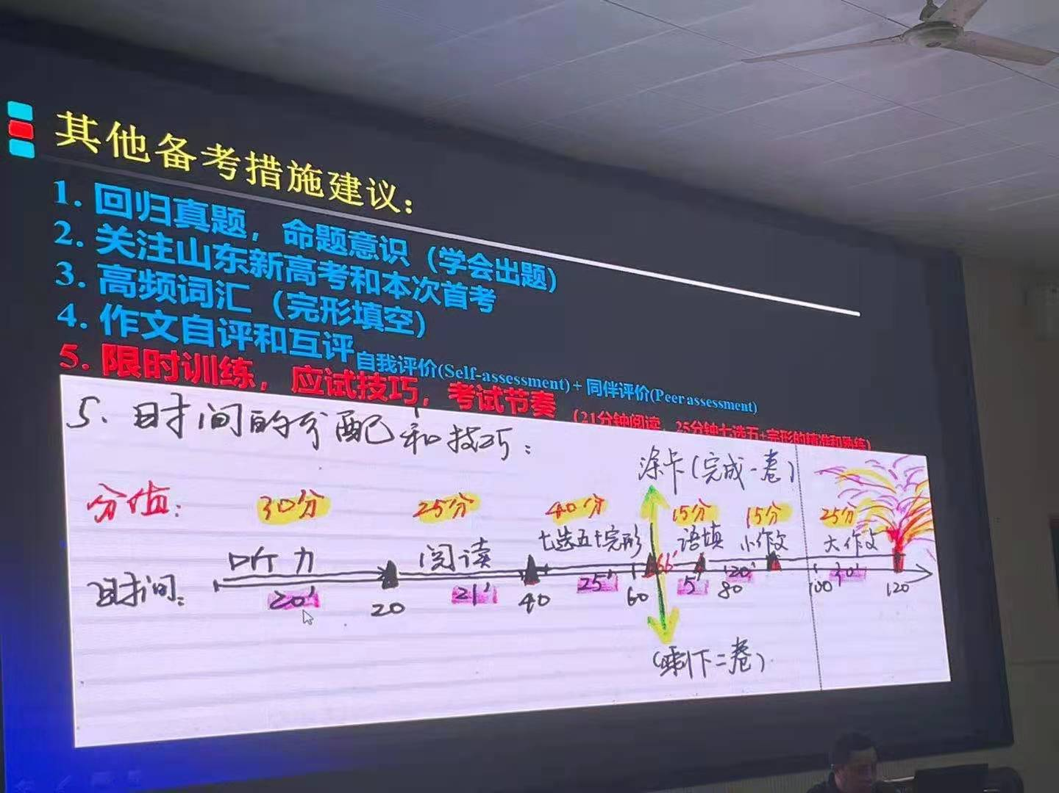
其他备考建议:
1.回归真题,命题意识(学会出题)
2.关注山东新高考和本次首考
3.高频词汇(完形填空)
4.作文自评和互评(自我评价Self-assessment+同
伴互评peer-assessment)
5.限时训练,应试技巧,考试节奏(21分钟阅读,
25分钟七选五+完形的精准和熟练)

Slide 90
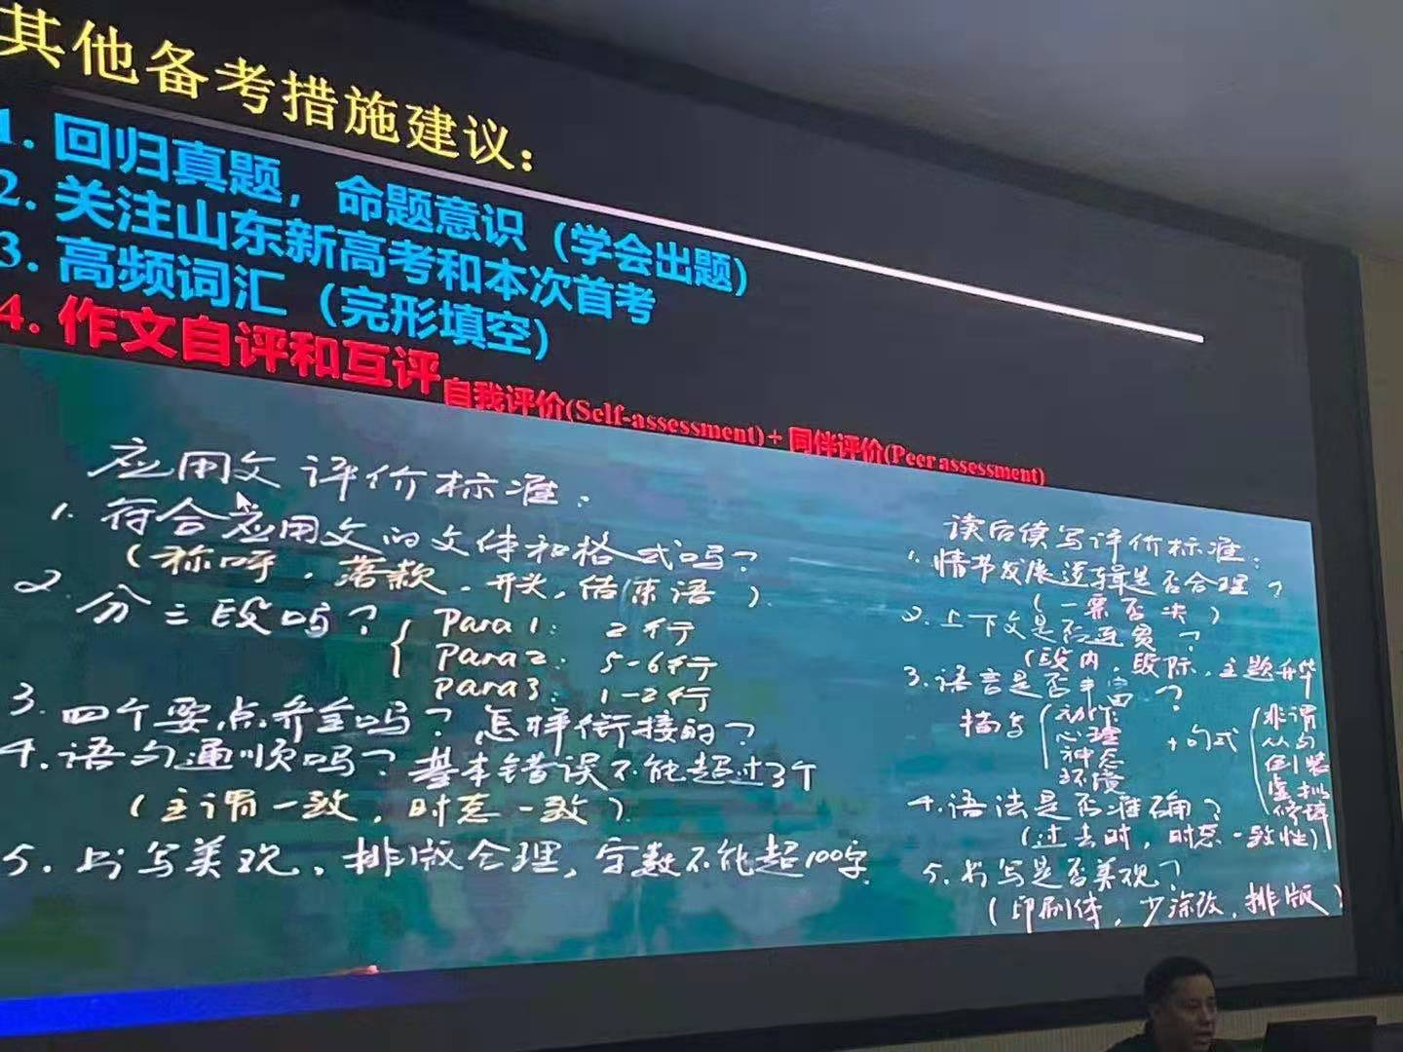
其他备考建议:
1.回归真题,命题意识(学会出题)
2.关注山东新高考和本次首考
3.高频词汇(完形填空)
4.作文自评和互评(自我评价Self-assessment+同
伴互评peer-assessment)
5.限时训练,应试技巧,考试节奏(21分钟阅读,
25分钟七选五+完形的精准和熟练)

Slide 91
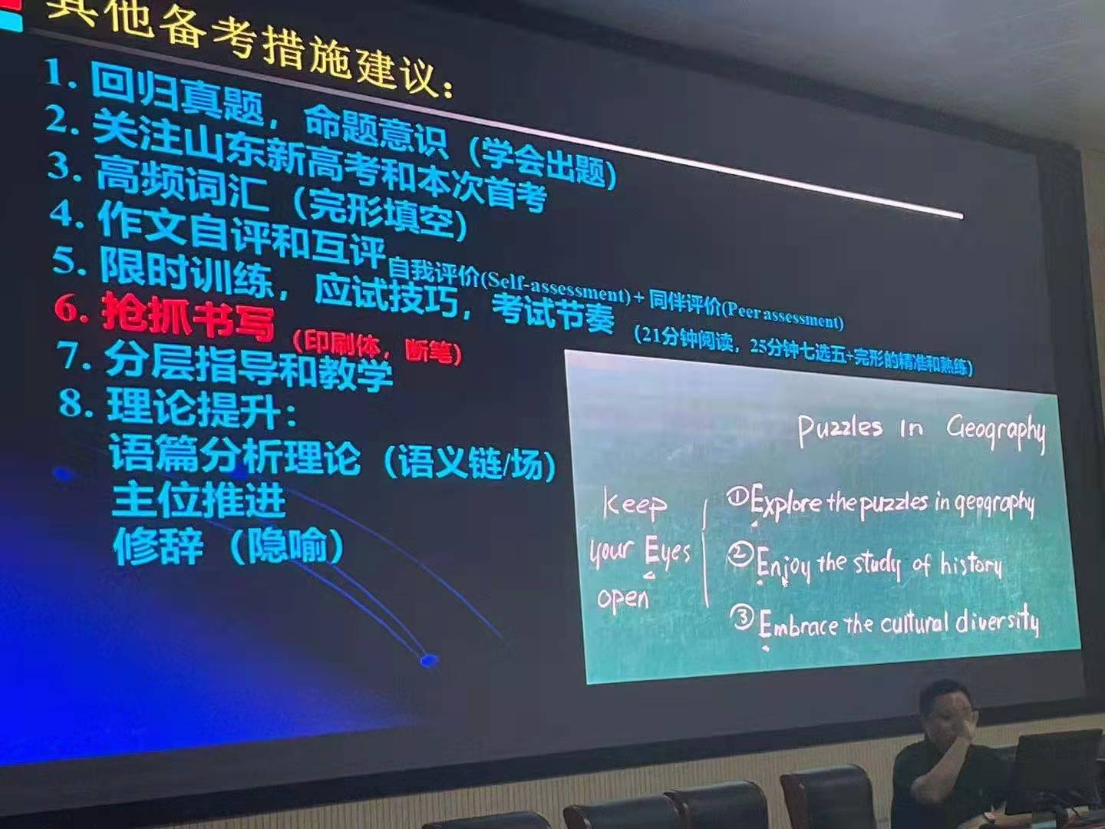
其他备考建议:
1.回归真题,命题意识(学会出题)
2.关注山东新高考和本次首考
3.高频词汇(完形填空)
4.作文自评和互评(自我评价Self-assessment+同
伴互评peer-assessment)
5.限时训练,应试技巧,考试节奏(21分钟阅读,
25分钟七选五+完形的精准和熟练)
6.抢抓书写
7.分层指导和教学
8:理论提升:
语篇分析理论(语义链/场)
主位推进
修辞(隐喻)

